Slide 1
Flash Flood Guidance System Approach
Christina Thaele

Slide 2
Systematic Forecasting Process
Monitor Precursors
Identify any potential severe weather hazard
Potential Flooding
1. Analyse FFGS
3. Issue alerts for Flash Flood
Verify FFG model against observations & rain forecasts
Analyse trends in FFGS
Determine flood probability
4. Validate & monitor
Flash Flood occurrence
Observations
EPS Products (NCEP, SREPS, EFI)
LM severe wx products
NWP
3. Issue alerts for Gales
Potential Gales
2. Analyse UM
4. Validate & Monitor wind
Other hazards (gales, snow, etc)
3. Analyse …
3. Issue alerts for …
4. Validate & Monitor …

Slide 3
1. Monitor precursors for potential flash floods
Flood related weather systems in observations:
synoptic maps, satellite, radar, etc.
Indication of potential heavy rain by EPS
NCEP, ECMWF EFI, SREPS
Analyze potential threats in NWP
UM weather patterns, rainfall, etc
Other data available:
River gauge water levels from DWA

Slide 4
2. Analyze SARFFG
Verify FFGS model rain against observations and forecast
Evaluate the FFGS MAP against observations and NWP
Evaluate NWP model
Analyze trends in FFG model
Identify areas of high soil moisture fraction ASM
Identify areas of low FFG values
Analyze basin trends where possible
Determine the subsequent likelihood of flash floods
Compare MAP with FFG (PFFT)
Compare FMAP with FFG (FFFT)
Compare prev FFG with MAP (IFFT)

Slide 5
4. Validate and monitor occurrence of flash floods
Investigate data sources and feedback, media reports, word of mouth, etc.
Provide updates if necessary to disaster management and media
Continue to monitor flash floods and other hazards

Slide 6
The Daily Flash Flood Guidance system approach: Document

Slide 7
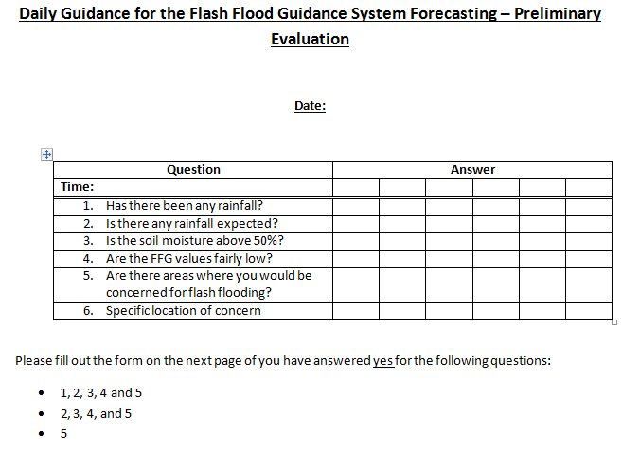
Current date/date of issue
At time of issue
MAP
FMAP
ASM
FFG
Known FF prone area or report already received
If yes go to the detailed evaluation report

Slide 8
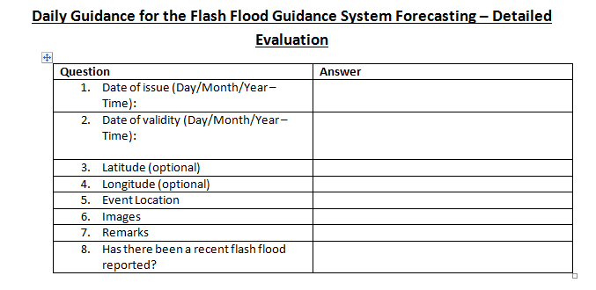
Current date and times
The system only detects the potential for FF within the next 6 hours
If there has been a reliable report and rainfall is still expected over the area this will trump the whole FFG system and a warning must be issued.
On the other hand it may also act as a confirmation and if the system moves over a new area with similar properties then the threat could be high
Could include a map of the area of interest
All images can either be put into this document or into a folder with the reference to them indicated in the table eg. Fig. 1 etc

Slide 9
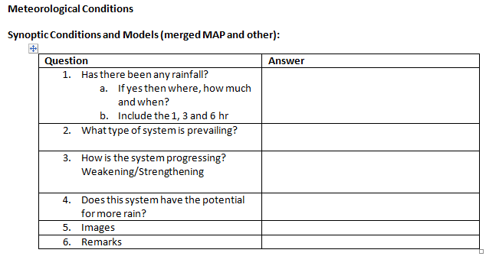
MAP/Model data/Satellite data/observations
Gauge data/Satellite/MAP
Amounts in mm for the past 1, 3 and 6hours – will be compared to the FFG
Cut-off low, tropical low etc. NB slow moving system more favourable
If it is strengthening the threat could be greater and visa versa
Yes/No answer
Use this to discuss the satellite rainfall products or radar rainfall products (MWGHE, GHE and SAWS HE). How well do they compare to observations and are they over or underestimating rainfall etc.
Picture of Satellite, Rainfall Gauge Data map, MAP products, etc.
On the MAP products you can indicate the area of concern etc.

Slide 10
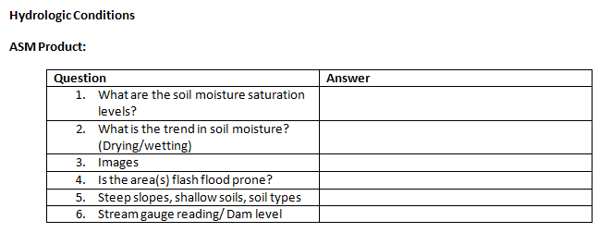
ASM/any info on soil properties/hydrological data etc
Look at ASM: SARFFG (updated every 6 hours)
Look at previous hours
Include images of ASM to support above
Information available from various sources including the internet:
Important to get familiar with soil types etc in each province as it will help to explain the response the system will have in an area
Local knowledge of the area from experience or from Hydrologist
May be obtained from hydrology department

Slide 11
UM model used in SARFFG – UM high resolution
Other models can be used as well
Look at FMAP and indicate amounts in the next 1, 3 and 6 hours (will be compared to FFG
Images to support above
May be important as threat may not be as great in the next 6 hours but significant amounts of rainfall may still be expected in the next 24 hours – thus a “heads up”
Compare the last 1, 3 or 6 h FMAP with the current 1, 3 or 6h MAP – you may look further back as well
Will give an idea how well the model is performing especially with regards to the amount, timing and distribution of rainfall

Slide 12
FFG product
Give as much detail as possible as it will be used to compare to the MAP and FMAP products
Any images to support the above

Slide 13
Draw together the products.
Compare the MAP to prev FFG and take ASM into account – see if there is any threat currently (IFFT)
Use MAP for next 1, 3 or 6 hours and compare to FFG, taking ASM into account as well (PFFT)
Compare FMAP to FFG and take ASM into account (FFFT)
Not only consider ASM also discuss soil properties/depths, slopes etc
Brief discussion on reasons for alert or no alert and any potential for threats beyond 6 hours.
Severe weather work instructions (South Africa):
Watch: Threat beyond 3 hours (or low confidence)
Warning: Threat within the next 1 – 3 hours (or a high confidence)
Since the system currently can only be used for the next 6 hours a FF alert can only be issued with such a short lead time

Slide 14
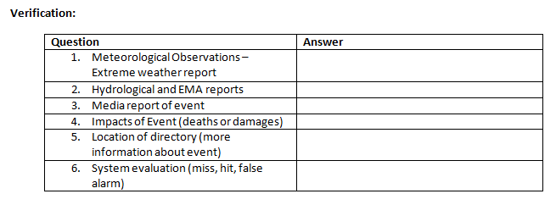
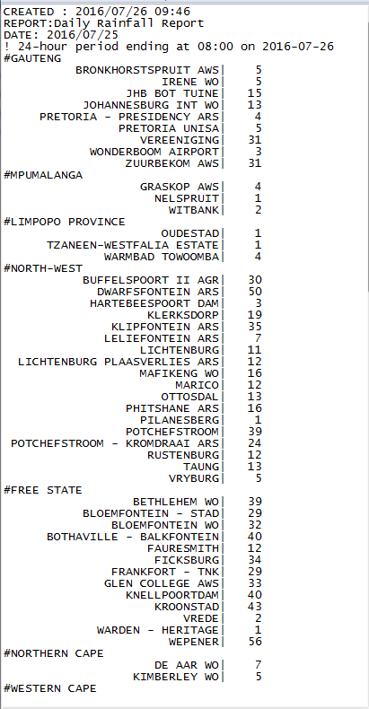

Slide 15
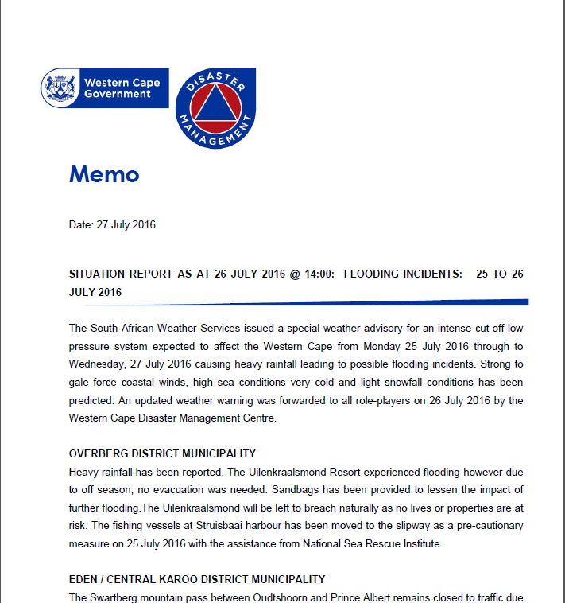

Slide 16
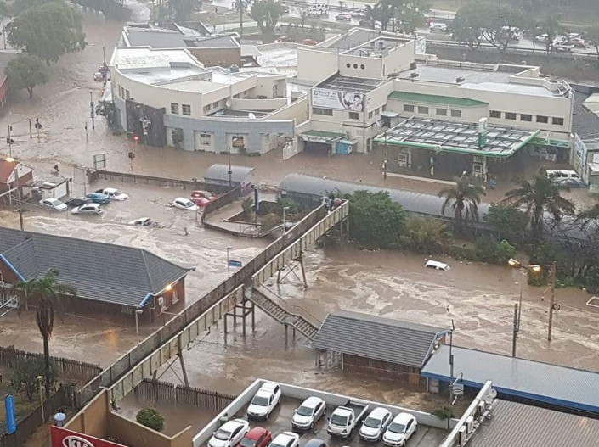
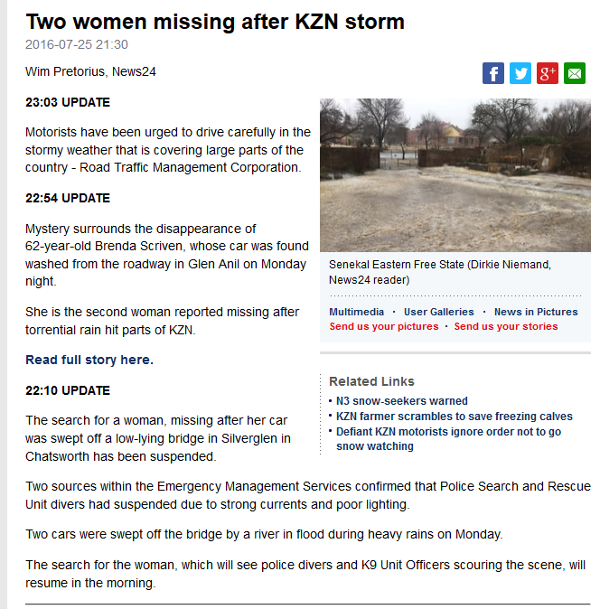
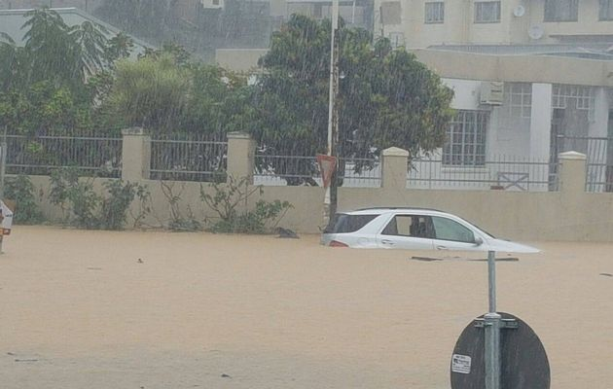

Slide 18
Summary
FFGS needs to be used as part of a larger set of information for decision making
FFGS provides guidance
Use it in a logical way as part of a systematic approach to flash flood forecasting, from EPS assessment, to forecaster interface detail

